Slide 1

A King County House Sales Analysis
TROY STEVE

Slide 2

Business understanding
Picket Partners Realty are new kids in the real estate industry. They want to sell their houses at competitive prices and they understand very well that only doing analysis won't help in this but buy come up with the best model that will help predict the house prices. We've been tasked to come up with this model using the existing Kings County data. We will use regression modeling to analyze house sales.

Slide 3

Data Used
kc_house_data.csv

Slide 4
Process
Data Loading
Data Cleaning
Data Exploration
Data
Modeling

Slide 5
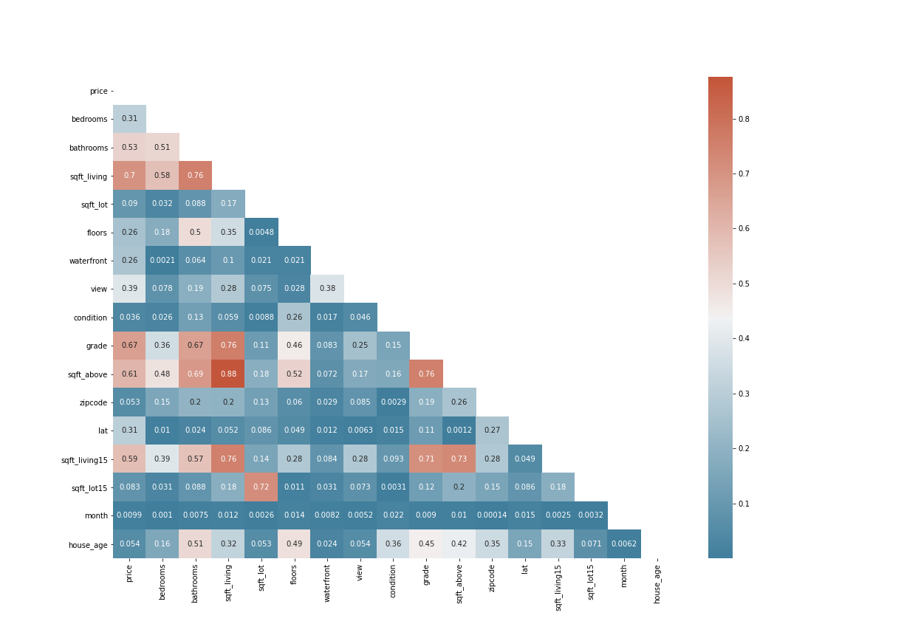
Correlation between various variables

Slide 6
Features selected
Bedrooms
Bathrooms
waterfront
grade
Zipcode
lat
sqft_living
sqft_living15

Slide 7
Recommendations
Those who wish to increase the prices of their houses should consider constructing or adding the square footage of their houses.
In so doing, they should endeavor to use quality materials in order to increase the grade of the houses. More bedrooms also have a positive relationship with house prices.
It seems houses located in certain places demand higher prices than other places.

Slide 8
Limitations and Next Steps
Although our model tries to predict prices in the best way possible, more analysis will need to be done. This is because we still violated some assumptions even after doing away with some features in order to deal with multicollinearity. We removed the outliers from our price column. This means that our model doesn't predict correctly the extreme prices.

